Slide 1

Firewall Automation Scripting with Python and REST APIs
By Thomas Barnett

Slide 2
Objectives
Understanding Firewalls
The Need for Automation
Beginner’s Guide to REST APIs
Python Scripting

Slide 3

What is a Firewall?
Understanding Firewalls
A firewall is network security device that monitors and controls network ingress and egress traffic.
A firewall can be hardware (i.e. Network Security Appliance) or software (i.e. Host-Based)
Analogous to a bouncer at a nightclub- it is responsible for permitting or denying the entrance/exit of data flowing in or out of the network

Slide 4
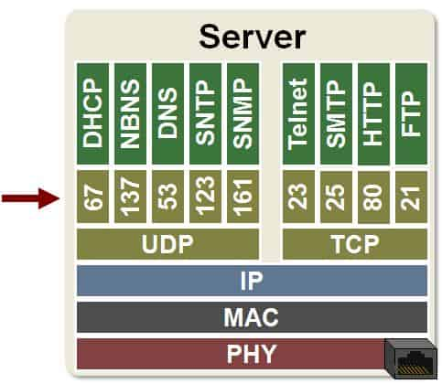
Zones and Ports
Understanding Firewalls
Zones are security boundaries used by firewalls, routers, and controllers.
Examples of common zones:
LAN → your internal network
WAN → the internet
GUEST → isolated visitor network
DMZ → semi-secure area for public-facing servers
IOT → smart devices segregated from users
VPN → remote-access clients
Zones help you define who can talk to who.
A port is a number representing a specific application or service running on a device.

Slide 5
Host-based Firewalls
Understanding Firewalls
Firewall Software that runs on an endpoint (PCs, mobile devices, servers, etc.)
Examples: Windows Defender, Iptables, nftables, ufw, firewalld
Good to enforce as a part of a defense-in-depth strategy, but not enough on their own
Limitations: Defends one device only, can be disabled by malware, no DDOS mitigation, can’t stop lateral movement, no support for network equipment or IoT devices

Slide 6
First Gen Firewalls - Packet-Filtering
Understanding Firewalls
“Simple”
Makes Decisions based off of most basic packet information:
  Dest. IP
  Src. IP
  Port Number
  Protocol (TCP, UDP, ICMP, etc.)
These Firewalls lack context and application awareness
They are vulnerable to spoofing attacks

Slide 7
Second Gen - Stateful Inspection
Understanding Firewalls
Keeps track of active sessions and maintains a “state table”
Automatically allows legitimate return traffic
Still is not application aware:
  For example- would not be able to detect DNS over HTTPS (DoH)

Slide 8
3rd Gen - Proxy Firewall
Understanding Firewalls
Application Aware
Often Used for Content Filtering
Can perform deep packet inspection
Intercepts and forwards packets on behalf of clients, inspecting requests and replies
The main downside is that there can be increased latency due to performance overhead:
  Inspection eats up resources

Slide 9
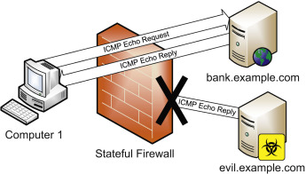
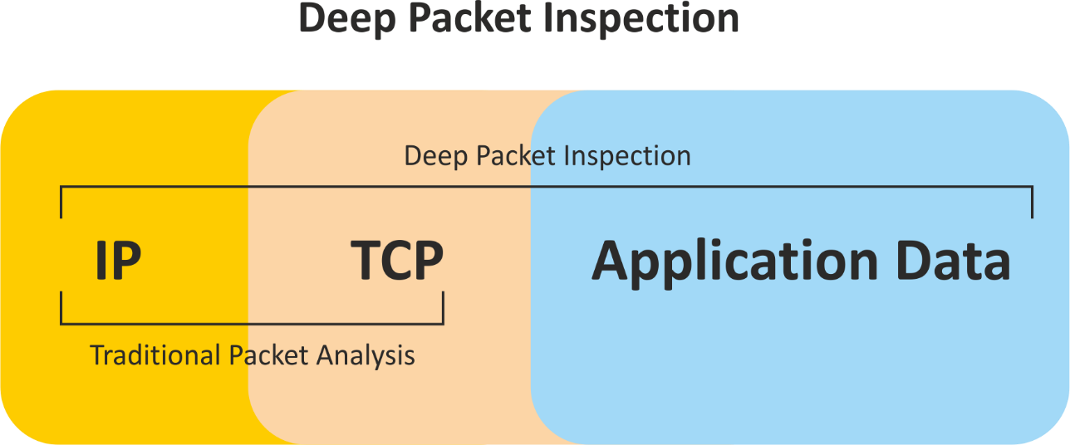
NGFWs - Next-Gen Firewalls
Understanding Firewalls
Includes features from previous generations with added sophistication
Introduces built-in IDS, IPS and Threat intelligence
The Downsides are that they are resource-intensive and expensive
Common in business/enterprise/government environment

Slide 10
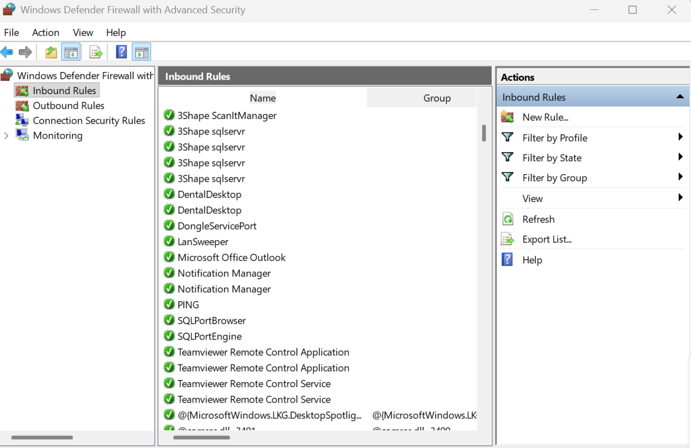
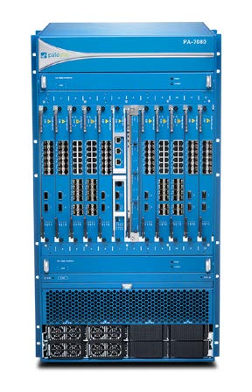
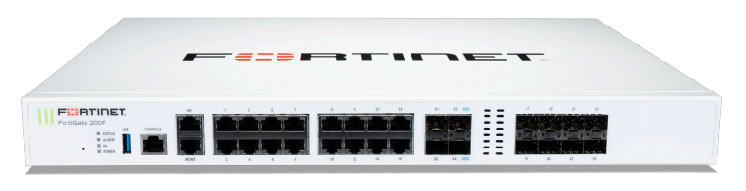

Slide 11
Firewall Concepts
Understanding Firewalls
Rules/Policies
Actions: Allow, Deny, and Drop
Default Deny
Statefulness and Statelessness
Logging and Auditing
Threat Protection
Cloud integration (ex. Palo Alto WildFire, Cloud Identity Engine, etc.)

Slide 12

Building a Firewall Rule
Understanding Firewalls
Rules/Policies
Actions: Allow, Deny, and Drop
Default Deny
Statefulness and Statelessness
Logging and Auditing
Threat Protection
Cloud integration (ex. Palo Alto WildFire, Cloud Identity Engine, etc.)

Slide 13
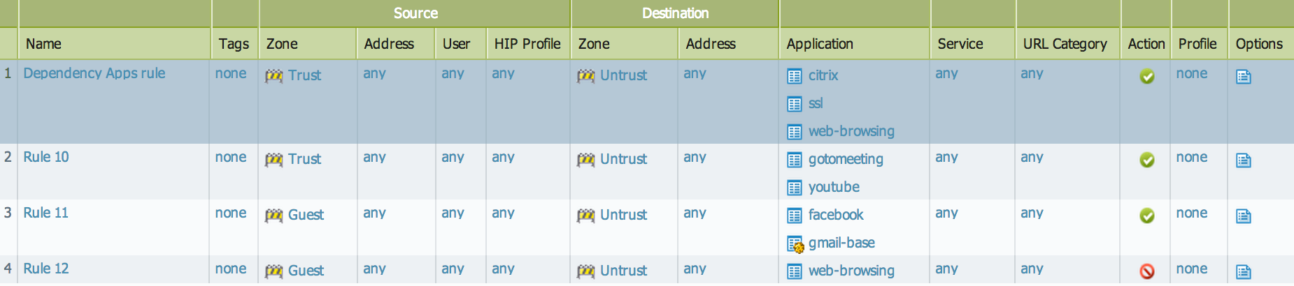
Firewall Rules- Visual
Understanding Firewalls

Slide 14
What is Network Automation?
Network automation is the process of using software, scripts, or tools to automatically configure, manage, test, deploy, and operate network devices and services—without relying on manual, device-by-device commands
Scenario 1-
Scenario 2-
Scenario 3-
An MSP manages 20+ firewalls across different client locations.
A new vendor requirement arrives: “Allow outbound TCP 443 to X.X.X.X/24 for all sites.”
The security team maintains a list of blocked IPs, approved SaaS IPs, and/or a list of malicious domains.
These change multiple times per day.
Manually updating the firewall URL blocklists, FQDN objects, and IP groups is impossible to keep up with.
A company (or MSP) brings up new branch offices frequently.
Each site needs identical baseline firewall configuration.
Doing this manually each time is slow and error-prone.
The Need for Automation
3 Scenarios that illustrate the need for Firewall Automation.

Slide 15
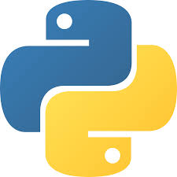
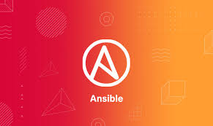
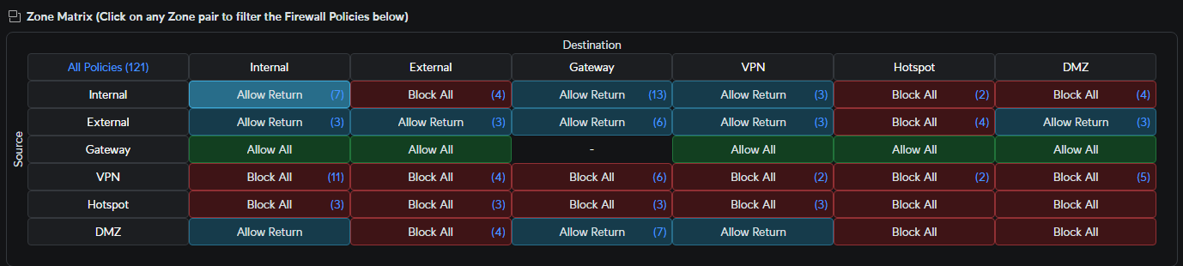
What you need to know
Scripting
Orchestration
When to use Scripting?
The Need for Automation
Writing code that interacts with networking appliances by retrieving, editing, and creating new configuration via exposed API endpoints or SSH connections.
SDN and FW Managers
Software Defined Networks provides a centralized controller with built in tools that facilitate automation. FW Managers are related and provide central management for Firewalls,
orchestration sits on top of network automation. Automation handles individual tasks, while orchestration chains those tasks together into full workflows
To automate a repetitive task
To ensure error-prone tasks are done properly
To enforce a standard or baseline config
To complete work at scale

Slide 16
Next steps
“Automation is not about replacing humans; it’s about removing the toil.”
Dive into RESTful APIs and writing our first Python script that actually makes an impact on our network.
“Automation is not a goal—it is a byproduct of good engineering.”
“Manual work is the enemy of flow.”
The Need for Automation
Kelsey Hightower
Patrick Debois
Gene Kim

Slide 17
Defining APIs
Beginner’s Guide to REST APIs
API = Application Programming Interface
What is an interface?
  https://en.wikipedia.org/wiki/Interface_(computing)
APIs allow software applications to communicate and integrate with each other without the applications needing to understand how the other’s underlying system works
There are many types of APIs: GraphQL, SOAP, gRPC… but the most widely used APIs are REST APIs

Slide 18
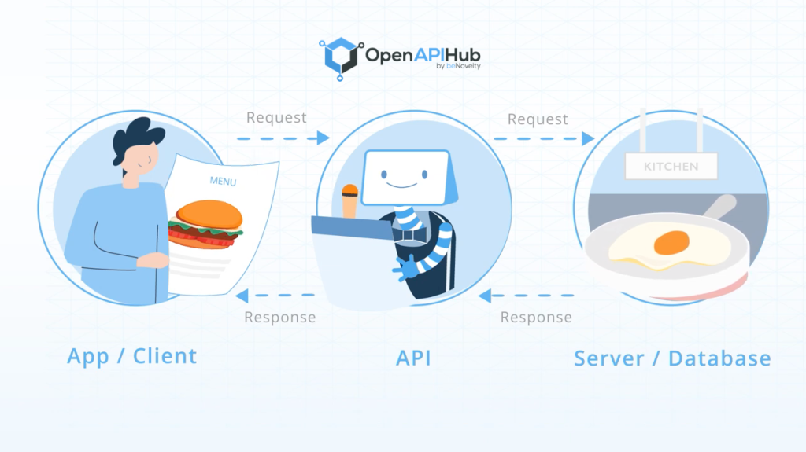
API Analogy- The Restaurant
Beginner’s Guide to REST APIs

Slide 19
API Terminology
Beginner’s Guide to REST APIs
Client: The entity requesting data (typically software)
Server: The entity responding to requests (database, network device, application)
Endpoint: A specific URL path that represents a resource
Resource: The “thing” an endpoint represents
HTTP Method: Defines the action to take on a resource (verb)
Status Code: A numeric indicator of the result of your request
Header: Metadata about the request or response
Query Parameters: Extra values added to the end of a URL to filter or modify a request

Slide 20
API Terminology Part 2
Beginner’s Guide to REST APIs
Request Body: Data you send in the request with POST/PUT/PATCH typically JSON
Response Body: The JSON the API sends back
Rate Limiting: Limits on how many requests you can make per time period
Pagination: Breaking large data sets into smaller chunks
Webhooks: Reverse APIs—where the server sends data to you when an event happens
REST: Representational State Transfer. A style of API that uses HTTP verbs and resources

Slide 21
How The Process Works
Beginner’s Guide to REST APIs
You send a request to an API’s endpoint (a specific URL).
The request includes an HTTP method (GET, POST, PUT, DELETE) that tells the API what action you want.
You also send authentication (API key, bearer token, OAuth, etc.) so the API knows who you are.
You may include extra data (JSON) if you're creating or updating something.
The API processes your request and sends back a response with:
a status code (200, 201, 400, 401, etc.)
a response body (usually JSON with the data you asked for)
Your script or app reads the response and does something with the data

Slide 22
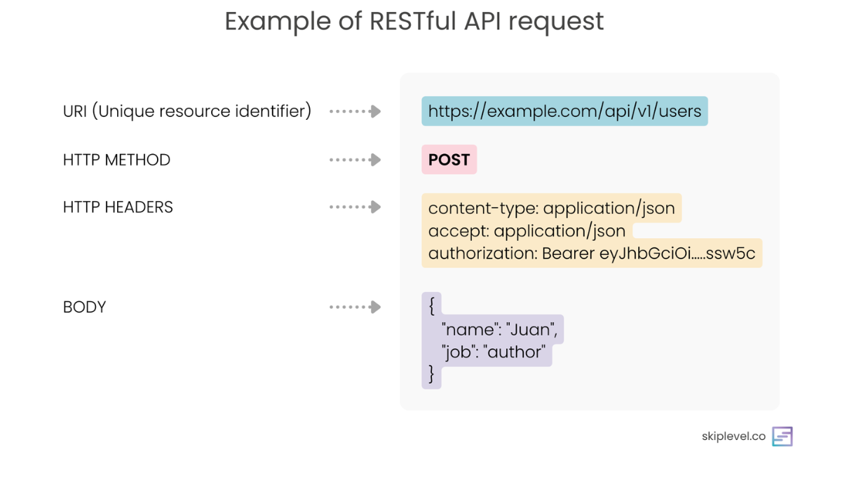
Beginner’s Guide to REST APIs

Slide 23
Methods and CRUD
Beginner’s Guide to REST APIs
HTTP Methods:
POST
GET
PATCH, PUT
DELETE
CREATE
READ
UPDATE
DELETE

Slide 24
Different API Authentication Types
API Key
Basic Authentication
Bearer Token
OAuth2
Beginner’s Guide to REST APIs
Simple to use
Not tied to a user (usually tied to a project or app)
No expiration unless manually rotated
No built-in scopes/permissions
Best For:
Internal automation
Low-risk operations
Sends a username and password encoded in Base64.
Example:
Authorization: Basic dXNlcjpwYXNz
Very old method
Credentials never expire unless changed
Requires HTTPS or it exposes passwords
Best for
Temporary testing
Legacy systems
A token (string) is sent in the header.
Example:
Authorization: Bearer eyJhbGciOiJIUzI1Ni…
Usually time-limited
More secure than API keys
Does not expose usernames/passwords
Often generated through an OAuth server
Best for
Modern REST APIs
Cloud services (Meraki, UniFi, Microsoft, Google)
A multi-step authorization framework where the client obtains:
an access token (short-lived)
a refresh token (long-lived)
Most secure modern method
Built-in scopes (“read-only,” “manage devices,” etc.)
Tokens expire and can be refreshed
Forces HTTPS and modern security
Best for
Cloud platforms
Apps requiring user login
Situations where permissions must be granular

Slide 25
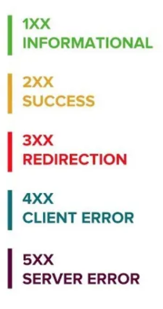
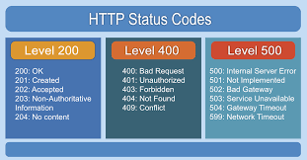
HTTP Status Codes
Beginner’s Guide to REST APIs

Slide 26



Set Up A Comfortable Code Environment
Python Scripting
1. Create a Project Folder
Version Control
Organization
2. Create a Python Virtual Environment
Prevents conflicts
Install different version of libraries
3. Install Required Python Packages
requests → makes API calls easy
python-dotenv → safely loads secrets from .env
4. Install VS Code and Extensions
Python (core language support)
DotEnv (for syntax highlighting)

Slide 27
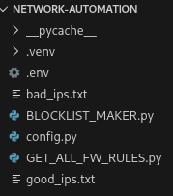

Project Structure and Config
Python Scripting
1. Create Your Project Structure
2. Use a .env File for Sensitive Data

Slide 28
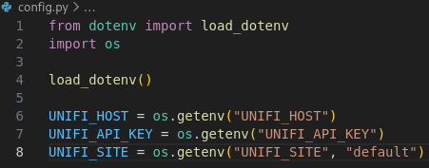
Project Structure and Config Cont.
Python Scripting
3. Load Configuration Through config.py
Gives you a clean way to reference environment variables throughout your entire project.
4. Collect input data
Good IPs List
Bad IPs List
Put these 2 txt files in same directory as your project

